Slide 1
Networking & Security Management

Slide 2
Network Deployment
Feature Configuration
Network Security Management
Network Monitoring
Network Maintenance

Slide 3
Network Deployment
Initial Configuration
Remote Installation
Configuration Automated Scripts

Slide 4
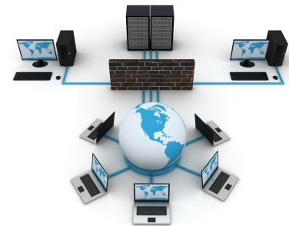
Network Deployment.

Slide 5
Feature Configuration
Interfaces Configuration/VLAN
Ethernet Switching Configuration
Routing

Slide 6
Network Security Management
Security Policy.
Shared/Reusable Security Policy And Objects.
Threat Mitigation
VPN Configuration
NAT (Network Address Translation)

Slide 7
Network Monitoring
Log & Reports.
Data & Application Activity.
Topology View.
Network Failure Recognition
High Availability
Hardware

Slide 8
Network Maintenance
Signature Updates.
Firewall Rule Adjustments.
Single/Multiple/Bulk/Shared Configuration.
Licenses.
OS Version Upgrade.
Adjust Routing.

Slide 9
Firewall Rule Adjustments
Firewall is a point of control and management.
Firewall Can Be Hardware Or Software.
Rules About Inbound and Outbound Traffic Can Be Defined
Unwanted Traffic Could Be Blocked.

